Slide 1
Please DOWNLOAD EAGLE and INSTALL
https://www.autodesk.com/eagle
We will be using the latest!

Slide 2
Who I am
@technolomaniac
github: sfgit
hackaday.io/matt
Email:
technolomaniac@gmail.com
matt.berggren@autodesk.com

Slide 3
How I self-identify?
Physicist
Electrical Engineer
Embedded SW Developer -ish
Radio / Wireless Junkie
>Trying to change the world<
…I build stuff (a LOT of stuff)
And I wish I was a mathematician

Slide 4
What I build…
Radios / RF Transceivers
Sensors & Control Stuff
Connected Hardware, Software, & Services
VERY High Precision “Detectors”
Electronics Design Software
Modular Electronics / Development Hardware

Slide 5
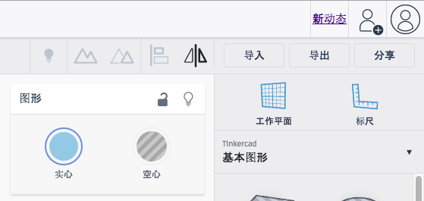
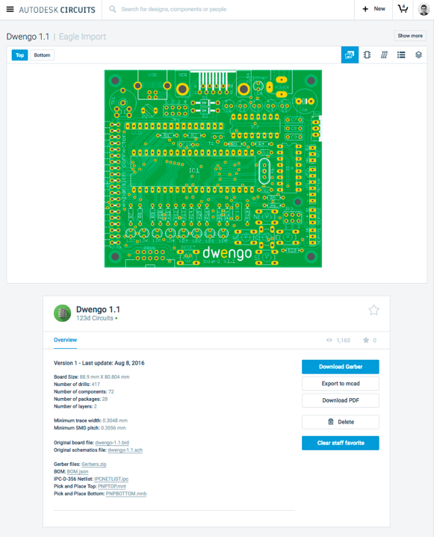
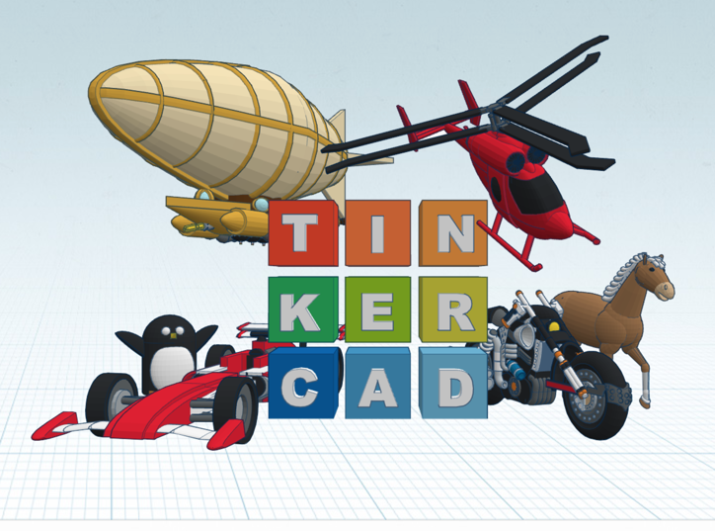
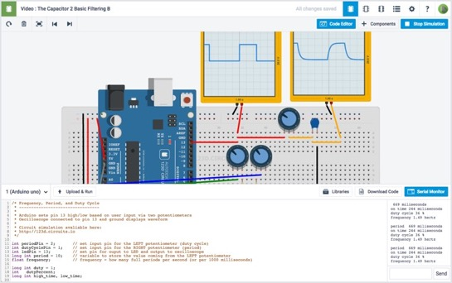

Slide 6
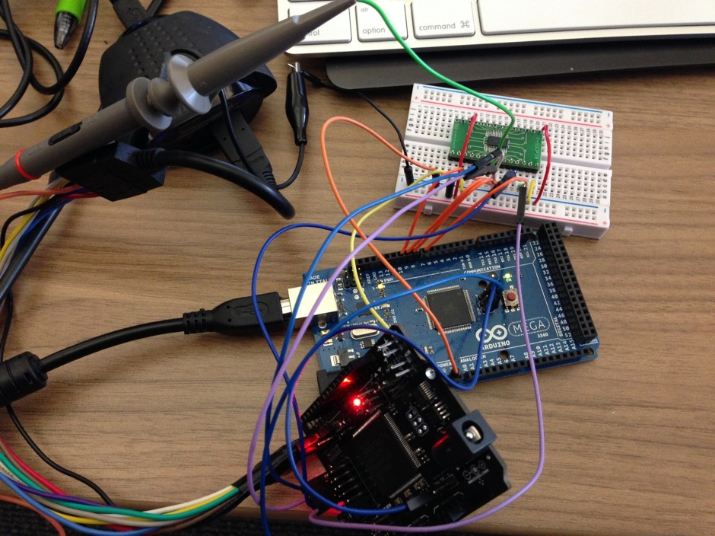
Where it all begins… (it’s ok, we all do this)
Figure 1. Modeling ideas with breadboard, prototype board and development kits

Slide 7
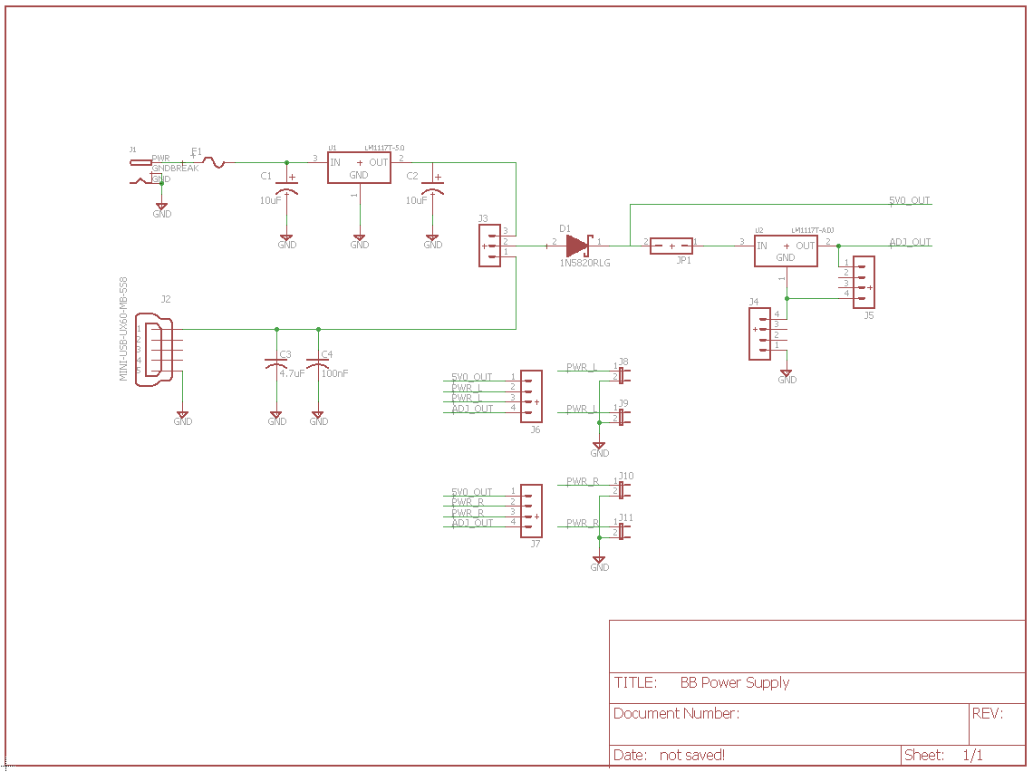
LOGICAL DESIGN (FLOW) - SCH

Slide 8
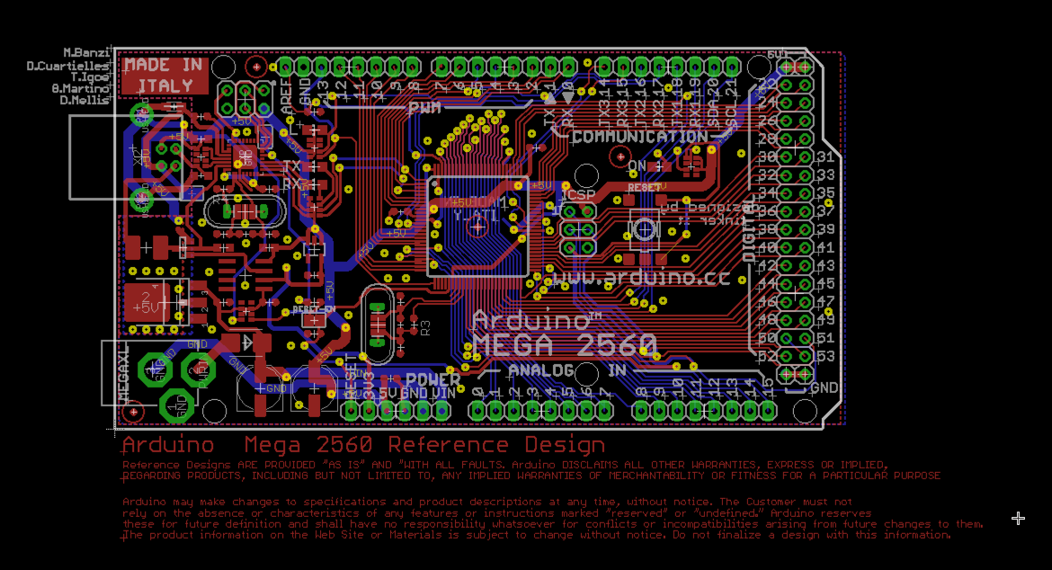
PHYSICAL Design
Notes:
So what’s next? There is a renaissance in hardware happening right now. Some people are calling it the hardware revolution. This revolution is really a convergence of several major trends happening in the space. And the end result is that it’s becoming easier and more economically viable for people to build things with hardware.
The hacker/maker movement has made hardware cool again. Hacklabs and makerspaces are springing up all over the world.
Arduino, raspberry pi, AVR, beaglebone have all emerged as easy entry point development platforms for people that aren’t EE’s but know how to code
3D printers and scanners have become a mass market product that allows people to imagine something and have a physical model within hours
Crowdfunding lets people guage market demand at the concept phase.
Specialized ems companies have sprung up all over the place that do quick turn prototyping. So now people can iterate on hardware products similarly to how they do with software
The barriers have come down for an individual or small company to get access to cheap, reliable volume production in China
IOT is driving a ton of new product ideas that are all hardware dependent. And analysts are predicting that it will be a massive market
Many of the major semi companies are jumping on the bandwagon. both Intel and TI announced major development efforts with Arduino. 2 years ago folks would have said that’s impossible.
More capital is coming into the space through incubators, accelerators and VCs will follow
From where I sit this all ads up to a big opportunity for supplyframe. There seem to be major parallels to how opens source drove a major wave in software.

Slide 9
The circuit design workflow
Conceptualization
Schematic Capture
PCB Layout
Computer Aided Manufacturing

Slide 10
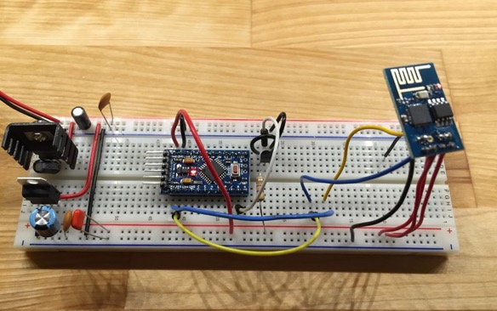
Breadboarding

Slide 11
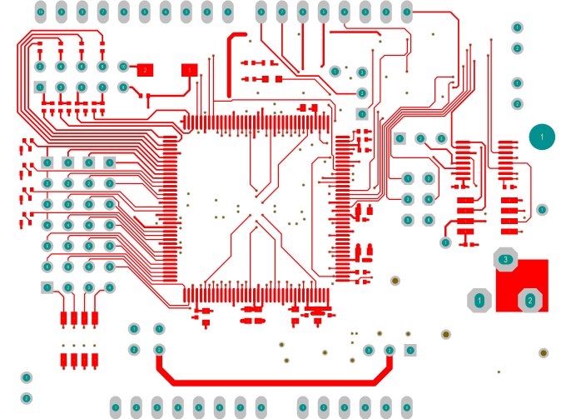
Building a PCB 101

Slide 12
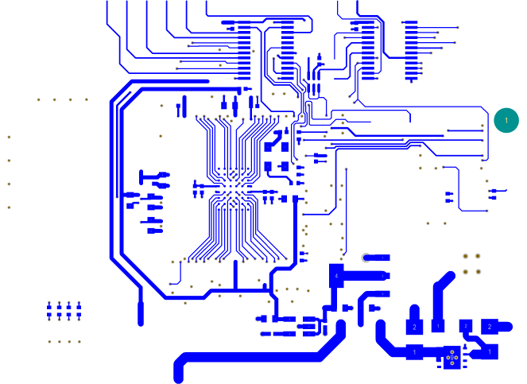
What is a PCB?
Connect electronic components together in meaningful ways

Slide 13
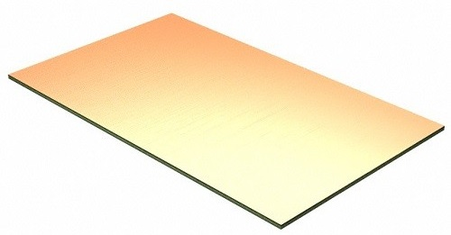
Pre-clad Copper Circuit Board Panel
Notes:
So what’s next? There is a renaissance in hardware happening right now. Some people are calling it the hardware revolution. This revolution is really a convergence of several major trends happening in the space. And the end result is that it’s becoming easier and more economically viable for people to build things with hardware.
The hacker/maker movement has made hardware cool again. Hacklabs and makerspaces are springing up all over the world.
Arduino, raspberry pi, AVR, beaglebone have all emerged as easy entry point development platforms for people that aren’t EE’s but know how to code
3D printers and scanners have become a mass market product that allows people to imagine something and have a physical model within hours
Crowdfunding lets people guage market demand at the concept phase.
Specialized ems companies have sprung up all over the place that do quick turn prototyping. So now people can iterate on hardware products similarly to how they do with software
The barriers have come down for an individual or small company to get access to cheap, reliable volume production in China
IOT is driving a ton of new product ideas that are all hardware dependent. And analysts are predicting that it will be a massive market
Many of the major semi companies are jumping on the bandwagon. both Intel and TI announced major development efforts with Arduino. 2 years ago folks would have said that’s impossible.
More capital is coming into the space through incubators, accelerators and VCs will follow
From where I sit this all ads up to a big opportunity for supplyframe. There seem to be major parallels to how opens source drove a major wave in software.

Slide 14
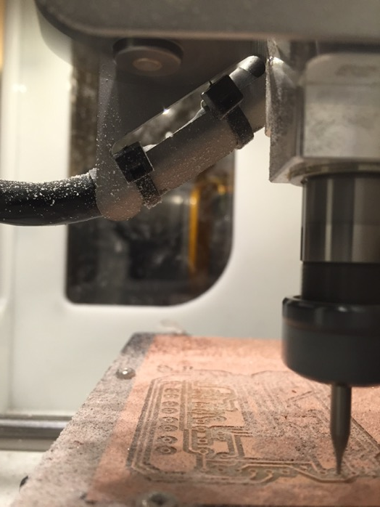
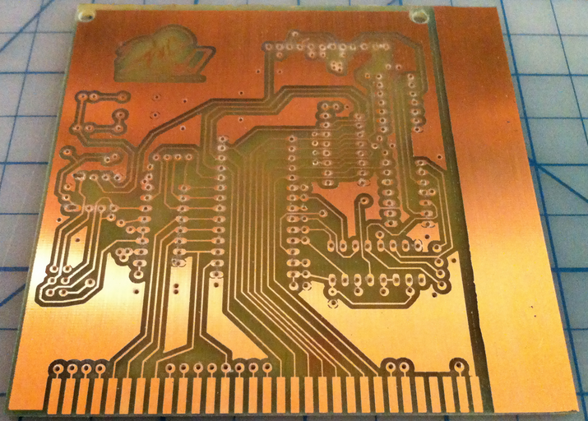
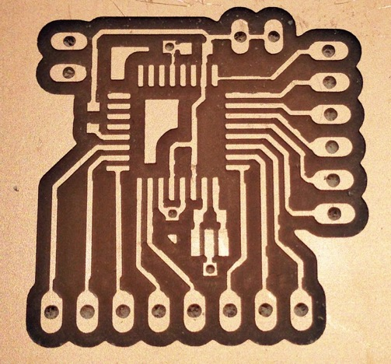
Routed Boards
No Components, No Mask (i.e. the green stuff)
Figure 3. Circuit routed from preclad PCB material
Notes:
So what’s next? There is a renaissance in hardware happening right now. Some people are calling it the hardware revolution. This revolution is really a convergence of several major trends happening in the space. And the end result is that it’s becoming easier and more economically viable for people to build things with hardware.
The hacker/maker movement has made hardware cool again. Hacklabs and makerspaces are springing up all over the world.
Arduino, raspberry pi, AVR, beaglebone have all emerged as easy entry point development platforms for people that aren’t EE’s but know how to code
3D printers and scanners have become a mass market product that allows people to imagine something and have a physical model within hours
Crowdfunding lets people guage market demand at the concept phase.
Specialized ems companies have sprung up all over the place that do quick turn prototyping. So now people can iterate on hardware products similarly to how they do with software
The barriers have come down for an individual or small company to get access to cheap, reliable volume production in China
IOT is driving a ton of new product ideas that are all hardware dependent. And analysts are predicting that it will be a massive market
Many of the major semi companies are jumping on the bandwagon. both Intel and TI announced major development efforts with Arduino. 2 years ago folks would have said that’s impossible.
More capital is coming into the space through incubators, accelerators and VCs will follow
From where I sit this all ads up to a big opportunity for supplyframe. There seem to be major parallels to how opens source drove a major wave in software.

Slide 15
Basic PCB Terminology

Slide 16
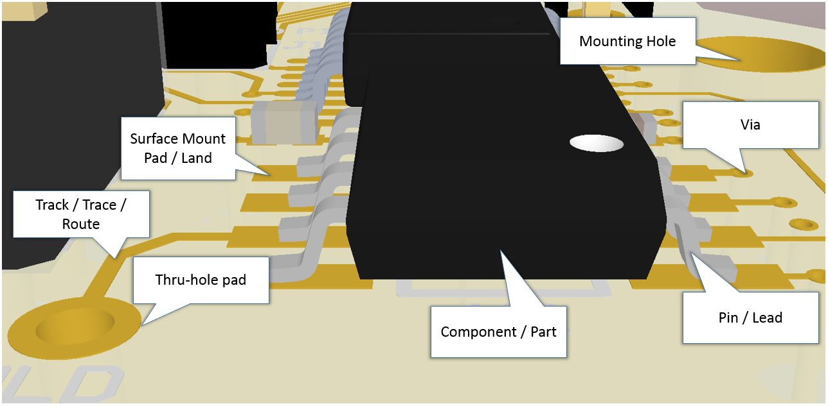
`
Some basic PCB terminology
Notes:
So what’s next? There is a renaissance in hardware happening right now. Some people are calling it the hardware revolution. This revolution is really a convergence of several major trends happening in the space. And the end result is that it’s becoming easier and more economically viable for people to build things with hardware.
The hacker/maker movement has made hardware cool again. Hacklabs and makerspaces are springing up all over the world.
Arduino, raspberry pi, AVR, beaglebone have all emerged as easy entry point development platforms for people that aren’t EE’s but know how to code
3D printers and scanners have become a mass market product that allows people to imagine something and have a physical model within hours
Crowdfunding lets people guage market demand at the concept phase.
Specialized ems companies have sprung up all over the place that do quick turn prototyping. So now people can iterate on hardware products similarly to how they do with software
The barriers have come down for an individual or small company to get access to cheap, reliable volume production in China
IOT is driving a ton of new product ideas that are all hardware dependent. And analysts are predicting that it will be a massive market
Many of the major semi companies are jumping on the bandwagon. both Intel and TI announced major development efforts with Arduino. 2 years ago folks would have said that’s impossible.
More capital is coming into the space through incubators, accelerators and VCs will follow
From where I sit this all ads up to a big opportunity for supplyframe. There seem to be major parallels to how opens source drove a major wave in software.

Slide 17
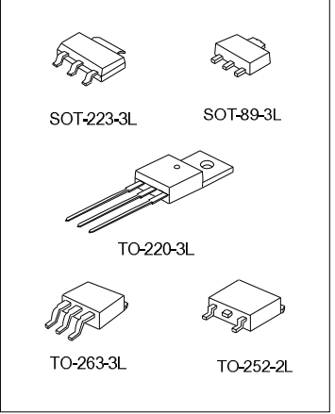
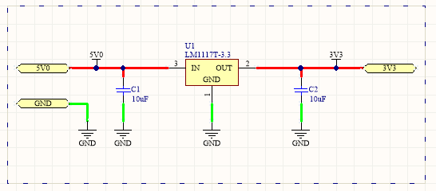
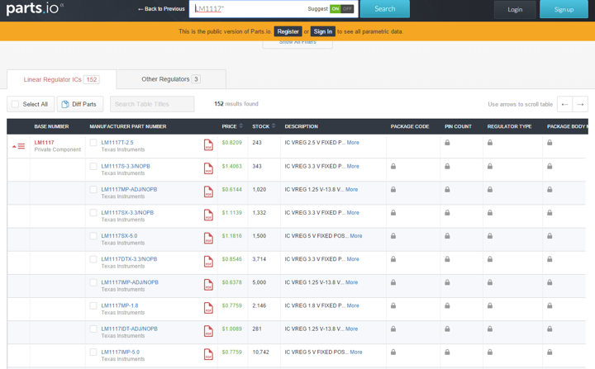
Components / Parts

Slide 18
Various Types of Component Packages
Figure 5. All the same part, different “packaging”
Notes:
So what’s next? There is a renaissance in hardware happening right now. Some people are calling it the hardware revolution. This revolution is really a convergence of several major trends happening in the space. And the end result is that it’s becoming easier and more economically viable for people to build things with hardware.
The hacker/maker movement has made hardware cool again. Hacklabs and makerspaces are springing up all over the world.
Arduino, raspberry pi, AVR, beaglebone have all emerged as easy entry point development platforms for people that aren’t EE’s but know how to code
3D printers and scanners have become a mass market product that allows people to imagine something and have a physical model within hours
Crowdfunding lets people guage market demand at the concept phase.
Specialized ems companies have sprung up all over the place that do quick turn prototyping. So now people can iterate on hardware products similarly to how they do with software
The barriers have come down for an individual or small company to get access to cheap, reliable volume production in China
IOT is driving a ton of new product ideas that are all hardware dependent. And analysts are predicting that it will be a massive market
Many of the major semi companies are jumping on the bandwagon. both Intel and TI announced major development efforts with Arduino. 2 years ago folks would have said that’s impossible.
More capital is coming into the space through incubators, accelerators and VCs will follow
From where I sit this all ads up to a big opportunity for supplyframe. There seem to be major parallels to how opens source drove a major wave in software.

Slide 19
Lands, Pads, Leads, Pins (?)
PTH – Plated Thru Hole
TH – Thru Hole
SMT / SMD – Surface Mount Technology / Device

Slide 20
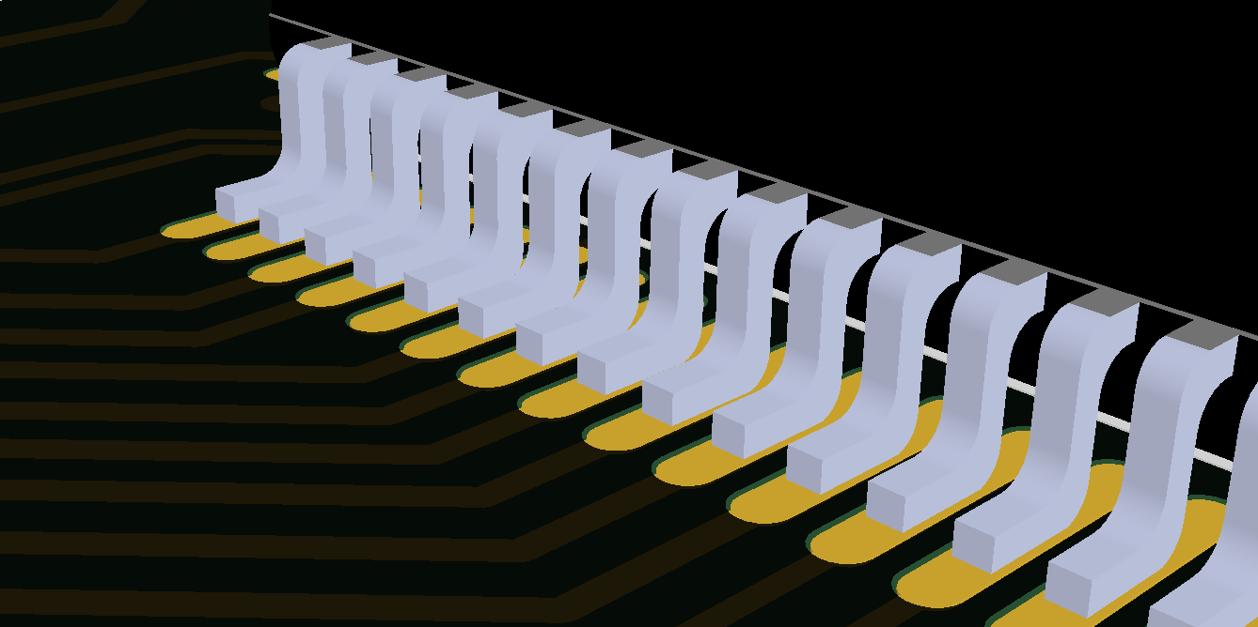
Component Pins on Pads / Lands
Figure 6. Component pins (gullwing leads) resting on surface mount pads on the top layer of a PCB
Notes:
So what’s next? There is a renaissance in hardware happening right now. Some people are calling it the hardware revolution. This revolution is really a convergence of several major trends happening in the space. And the end result is that it’s becoming easier and more economically viable for people to build things with hardware.
The hacker/maker movement has made hardware cool again. Hacklabs and makerspaces are springing up all over the world.
Arduino, raspberry pi, AVR, beaglebone have all emerged as easy entry point development platforms for people that aren’t EE’s but know how to code
3D printers and scanners have become a mass market product that allows people to imagine something and have a physical model within hours
Crowdfunding lets people guage market demand at the concept phase.
Specialized ems companies have sprung up all over the place that do quick turn prototyping. So now people can iterate on hardware products similarly to how they do with software
The barriers have come down for an individual or small company to get access to cheap, reliable volume production in China
IOT is driving a ton of new product ideas that are all hardware dependent. And analysts are predicting that it will be a massive market
Many of the major semi companies are jumping on the bandwagon. both Intel and TI announced major development efforts with Arduino. 2 years ago folks would have said that’s impossible.
More capital is coming into the space through incubators, accelerators and VCs will follow
From where I sit this all ads up to a big opportunity for supplyframe. There seem to be major parallels to how opens source drove a major wave in software.

Slide 21
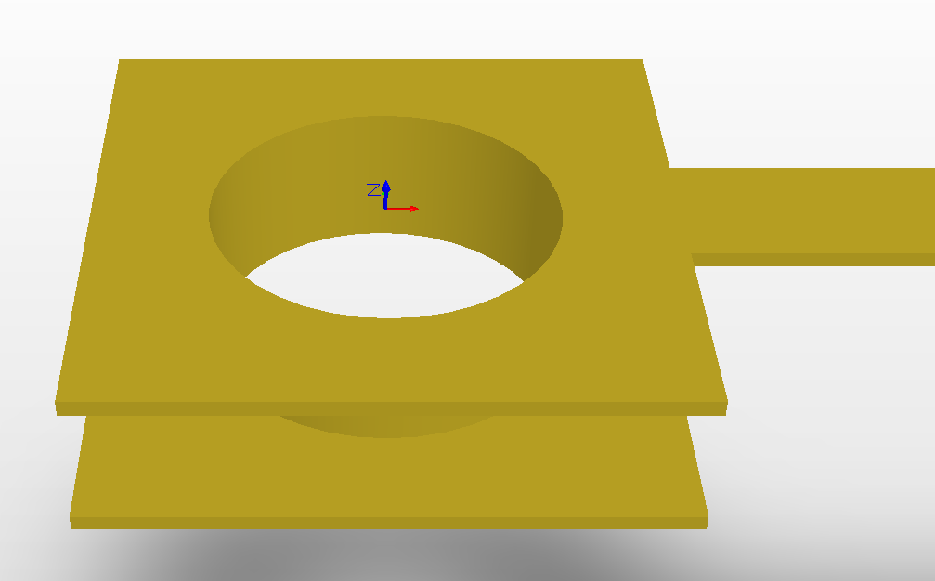
Plated Thru Hole Pad
Figure 7. Thru-hole pad with annular rings take solder on the top and bottom layers and a plated hole
Notes:
So what’s next? There is a renaissance in hardware happening right now. Some people are calling it the hardware revolution. This revolution is really a convergence of several major trends happening in the space. And the end result is that it’s becoming easier and more economically viable for people to build things with hardware.
The hacker/maker movement has made hardware cool again. Hacklabs and makerspaces are springing up all over the world.
Arduino, raspberry pi, AVR, beaglebone have all emerged as easy entry point development platforms for people that aren’t EE’s but know how to code
3D printers and scanners have become a mass market product that allows people to imagine something and have a physical model within hours
Crowdfunding lets people guage market demand at the concept phase.
Specialized ems companies have sprung up all over the place that do quick turn prototyping. So now people can iterate on hardware products similarly to how they do with software
The barriers have come down for an individual or small company to get access to cheap, reliable volume production in China
IOT is driving a ton of new product ideas that are all hardware dependent. And analysts are predicting that it will be a massive market
Many of the major semi companies are jumping on the bandwagon. both Intel and TI announced major development efforts with Arduino. 2 years ago folks would have said that’s impossible.
More capital is coming into the space through incubators, accelerators and VCs will follow
From where I sit this all ads up to a big opportunity for supplyframe. There seem to be major parallels to how opens source drove a major wave in software.

Slide 22
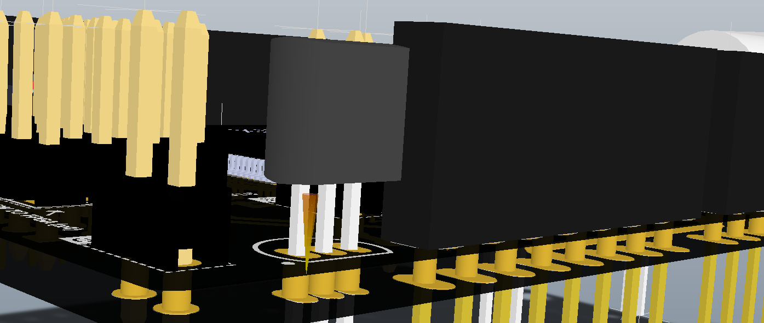
Cross Section of a PCB
Figure 7. Cross section of a printed circuit board
Notes:
So what’s next? There is a renaissance in hardware happening right now. Some people are calling it the hardware revolution. This revolution is really a convergence of several major trends happening in the space. And the end result is that it’s becoming easier and more economically viable for people to build things with hardware.
The hacker/maker movement has made hardware cool again. Hacklabs and makerspaces are springing up all over the world.
Arduino, raspberry pi, AVR, beaglebone have all emerged as easy entry point development platforms for people that aren’t EE’s but know how to code
3D printers and scanners have become a mass market product that allows people to imagine something and have a physical model within hours
Crowdfunding lets people guage market demand at the concept phase.
Specialized ems companies have sprung up all over the place that do quick turn prototyping. So now people can iterate on hardware products similarly to how they do with software
The barriers have come down for an individual or small company to get access to cheap, reliable volume production in China
IOT is driving a ton of new product ideas that are all hardware dependent. And analysts are predicting that it will be a massive market
Many of the major semi companies are jumping on the bandwagon. both Intel and TI announced major development efforts with Arduino. 2 years ago folks would have said that’s impossible.
More capital is coming into the space through incubators, accelerators and VCs will follow
From where I sit this all ads up to a big opportunity for supplyframe. There seem to be major parallels to how opens source drove a major wave in software.

Slide 23
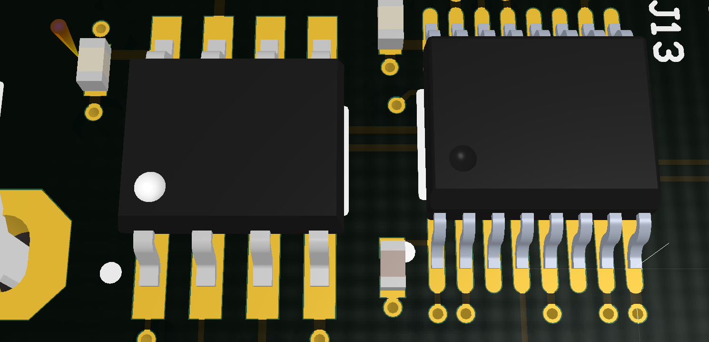
Pins on pads of a PCB footprint
Figure 8. Component pins make contact with slightly larger pads on the top layer of the PCB board
Notes:
So what’s next? There is a renaissance in hardware happening right now. Some people are calling it the hardware revolution. This revolution is really a convergence of several major trends happening in the space. And the end result is that it’s becoming easier and more economically viable for people to build things with hardware.
The hacker/maker movement has made hardware cool again. Hacklabs and makerspaces are springing up all over the world.
Arduino, raspberry pi, AVR, beaglebone have all emerged as easy entry point development platforms for people that aren’t EE’s but know how to code
3D printers and scanners have become a mass market product that allows people to imagine something and have a physical model within hours
Crowdfunding lets people guage market demand at the concept phase.
Specialized ems companies have sprung up all over the place that do quick turn prototyping. So now people can iterate on hardware products similarly to how they do with software
The barriers have come down for an individual or small company to get access to cheap, reliable volume production in China
IOT is driving a ton of new product ideas that are all hardware dependent. And analysts are predicting that it will be a massive market
Many of the major semi companies are jumping on the bandwagon. both Intel and TI announced major development efforts with Arduino. 2 years ago folks would have said that’s impossible.
More capital is coming into the space through incubators, accelerators and VCs will follow
From where I sit this all ads up to a big opportunity for supplyframe. There seem to be major parallels to how opens source drove a major wave in software.

Slide 24
Layers Signals, Routing, Stack-Ups

Slide 25
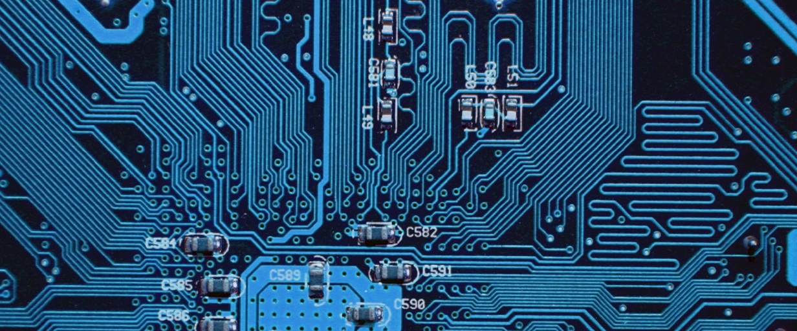
PCB Signal / Routing Layer
Figure 9. Signal layer with tracks and vias
Notes:
So what’s next? There is a renaissance in hardware happening right now. Some people are calling it the hardware revolution. This revolution is really a convergence of several major trends happening in the space. And the end result is that it’s becoming easier and more economically viable for people to build things with hardware.
The hacker/maker movement has made hardware cool again. Hacklabs and makerspaces are springing up all over the world.
Arduino, raspberry pi, AVR, beaglebone have all emerged as easy entry point development platforms for people that aren’t EE’s but know how to code
3D printers and scanners have become a mass market product that allows people to imagine something and have a physical model within hours
Crowdfunding lets people guage market demand at the concept phase.
Specialized ems companies have sprung up all over the place that do quick turn prototyping. So now people can iterate on hardware products similarly to how they do with software
The barriers have come down for an individual or small company to get access to cheap, reliable volume production in China
IOT is driving a ton of new product ideas that are all hardware dependent. And analysts are predicting that it will be a massive market
Many of the major semi companies are jumping on the bandwagon. both Intel and TI announced major development efforts with Arduino. 2 years ago folks would have said that’s impossible.
More capital is coming into the space through incubators, accelerators and VCs will follow
From where I sit this all ads up to a big opportunity for supplyframe. There seem to be major parallels to how opens source drove a major wave in software.

Slide 26
Cores, Common Stack-Ups, Multilayer PCBs

Slide 27
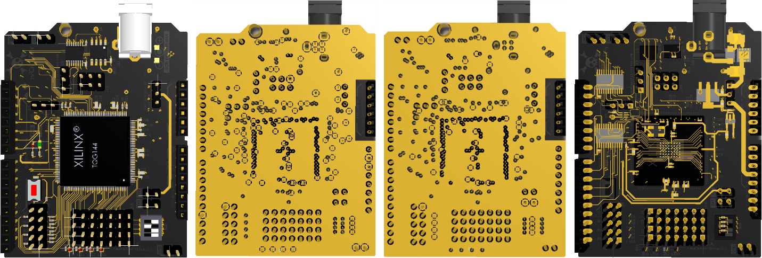
Layer by Layer 4-Layer PCB
Figure 10. Layer by layer view of a printed circuit board
Notes:
So what’s next? There is a renaissance in hardware happening right now. Some people are calling it the hardware revolution. This revolution is really a convergence of several major trends happening in the space. And the end result is that it’s becoming easier and more economically viable for people to build things with hardware.
The hacker/maker movement has made hardware cool again. Hacklabs and makerspaces are springing up all over the world.
Arduino, raspberry pi, AVR, beaglebone have all emerged as easy entry point development platforms for people that aren’t EE’s but know how to code
3D printers and scanners have become a mass market product that allows people to imagine something and have a physical model within hours
Crowdfunding lets people guage market demand at the concept phase.
Specialized ems companies have sprung up all over the place that do quick turn prototyping. So now people can iterate on hardware products similarly to how they do with software
The barriers have come down for an individual or small company to get access to cheap, reliable volume production in China
IOT is driving a ton of new product ideas that are all hardware dependent. And analysts are predicting that it will be a massive market
Many of the major semi companies are jumping on the bandwagon. both Intel and TI announced major development efforts with Arduino. 2 years ago folks would have said that’s impossible.
More capital is coming into the space through incubators, accelerators and VCs will follow
From where I sit this all ads up to a big opportunity for supplyframe. There seem to be major parallels to how opens source drove a major wave in software.

Slide 28
PCB Layer Stackup
*More common
Figure 11. Layer stackup of a typical 4 layer board
Notes:
So what’s next? There is a renaissance in hardware happening right now. Some people are calling it the hardware revolution. This revolution is really a convergence of several major trends happening in the space. And the end result is that it’s becoming easier and more economically viable for people to build things with hardware.
The hacker/maker movement has made hardware cool again. Hacklabs and makerspaces are springing up all over the world.
Arduino, raspberry pi, AVR, beaglebone have all emerged as easy entry point development platforms for people that aren’t EE’s but know how to code
3D printers and scanners have become a mass market product that allows people to imagine something and have a physical model within hours
Crowdfunding lets people guage market demand at the concept phase.
Specialized ems companies have sprung up all over the place that do quick turn prototyping. So now people can iterate on hardware products similarly to how they do with software
The barriers have come down for an individual or small company to get access to cheap, reliable volume production in China
IOT is driving a ton of new product ideas that are all hardware dependent. And analysts are predicting that it will be a massive market
Many of the major semi companies are jumping on the bandwagon. both Intel and TI announced major development efforts with Arduino. 2 years ago folks would have said that’s impossible.
More capital is coming into the space through incubators, accelerators and VCs will follow
From where I sit this all ads up to a big opportunity for supplyframe. There seem to be major parallels to how opens source drove a major wave in software.

Slide 29
Soldermask / Solder Resist

Slide 30
PCB Soldermask (colors may vary)
Figure 12. PCB Soldermask
Notes:
So what’s next? There is a renaissance in hardware happening right now. Some people are calling it the hardware revolution. This revolution is really a convergence of several major trends happening in the space. And the end result is that it’s becoming easier and more economically viable for people to build things with hardware.
The hacker/maker movement has made hardware cool again. Hacklabs and makerspaces are springing up all over the world.
Arduino, raspberry pi, AVR, beaglebone have all emerged as easy entry point development platforms for people that aren’t EE’s but know how to code
3D printers and scanners have become a mass market product that allows people to imagine something and have a physical model within hours
Crowdfunding lets people guage market demand at the concept phase.
Specialized ems companies have sprung up all over the place that do quick turn prototyping. So now people can iterate on hardware products similarly to how they do with software
The barriers have come down for an individual or small company to get access to cheap, reliable volume production in China
IOT is driving a ton of new product ideas that are all hardware dependent. And analysts are predicting that it will be a massive market
Many of the major semi companies are jumping on the bandwagon. both Intel and TI announced major development efforts with Arduino. 2 years ago folks would have said that’s impossible.
More capital is coming into the space through incubators, accelerators and VCs will follow
From where I sit this all ads up to a big opportunity for supplyframe. There seem to be major parallels to how opens source drove a major wave in software.

Slide 31
Solder Paste & Paste Mask

Slide 32
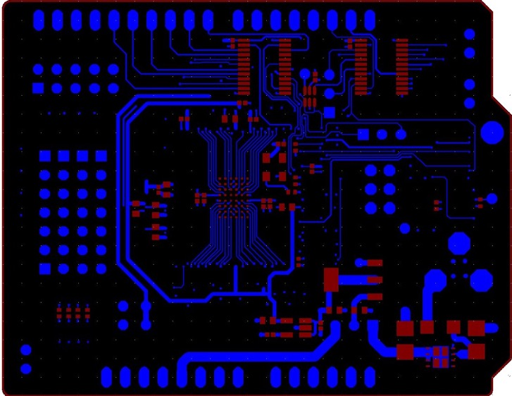
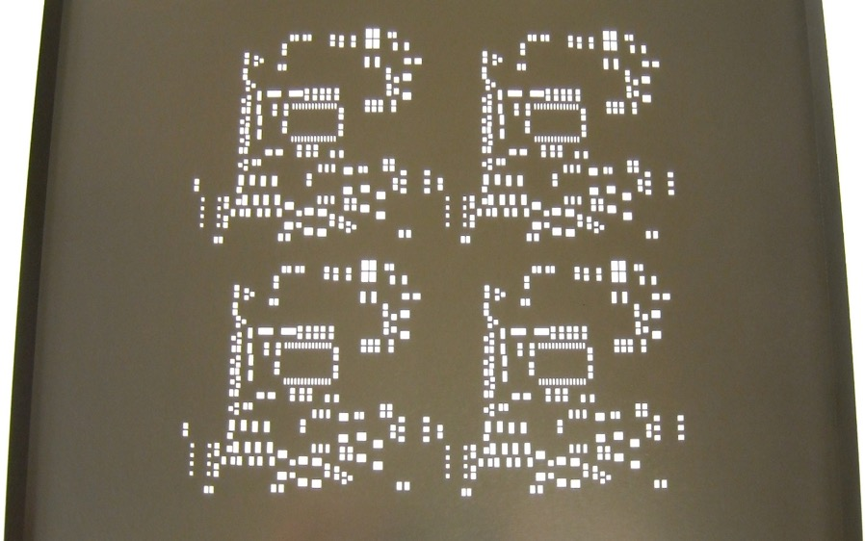
PCB Solder Paste Stencil
Figure 12. PCB File Paste Mask and Bottom Copper Layers
Figure 13. PCB Solder Paste Stencil
Notes:
So what’s next? There is a renaissance in hardware happening right now. Some people are calling it the hardware revolution. This revolution is really a convergence of several major trends happening in the space. And the end result is that it’s becoming easier and more economically viable for people to build things with hardware.
The hacker/maker movement has made hardware cool again. Hacklabs and makerspaces are springing up all over the world.
Arduino, raspberry pi, AVR, beaglebone have all emerged as easy entry point development platforms for people that aren’t EE’s but know how to code
3D printers and scanners have become a mass market product that allows people to imagine something and have a physical model within hours
Crowdfunding lets people guage market demand at the concept phase.
Specialized ems companies have sprung up all over the place that do quick turn prototyping. So now people can iterate on hardware products similarly to how they do with software
The barriers have come down for an individual or small company to get access to cheap, reliable volume production in China
IOT is driving a ton of new product ideas that are all hardware dependent. And analysts are predicting that it will be a massive market
Many of the major semi companies are jumping on the bandwagon. both Intel and TI announced major development efforts with Arduino. 2 years ago folks would have said that’s impossible.
More capital is coming into the space through incubators, accelerators and VCs will follow
From where I sit this all ads up to a big opportunity for supplyframe. There seem to be major parallels to how opens source drove a major wave in software.

Slide 33
Silkscreen (…And you thought they wouldn’t see)

Slide 34
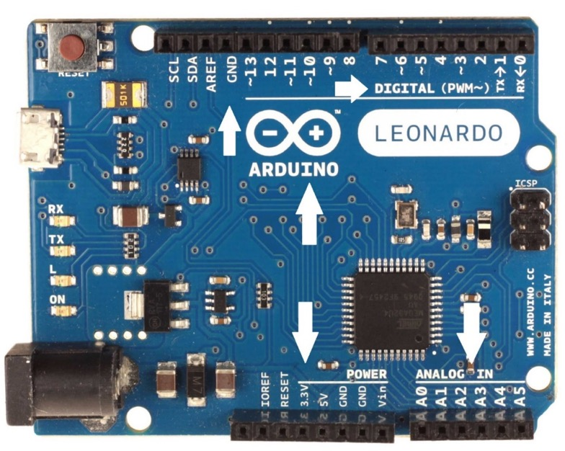
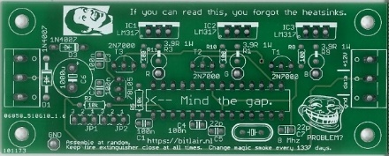
PCB Silkscreen Designators, notations are good Part numbers, values, etc. are not
Notes:
So what’s next? There is a renaissance in hardware happening right now. Some people are calling it the hardware revolution. This revolution is really a convergence of several major trends happening in the space. And the end result is that it’s becoming easier and more economically viable for people to build things with hardware.
The hacker/maker movement has made hardware cool again. Hacklabs and makerspaces are springing up all over the world.
Arduino, raspberry pi, AVR, beaglebone have all emerged as easy entry point development platforms for people that aren’t EE’s but know how to code
3D printers and scanners have become a mass market product that allows people to imagine something and have a physical model within hours
Crowdfunding lets people guage market demand at the concept phase.
Specialized ems companies have sprung up all over the place that do quick turn prototyping. So now people can iterate on hardware products similarly to how they do with software
The barriers have come down for an individual or small company to get access to cheap, reliable volume production in China
IOT is driving a ton of new product ideas that are all hardware dependent. And analysts are predicting that it will be a massive market
Many of the major semi companies are jumping on the bandwagon. both Intel and TI announced major development efforts with Arduino. 2 years ago folks would have said that’s impossible.
More capital is coming into the space through incubators, accelerators and VCs will follow
From where I sit this all ads up to a big opportunity for supplyframe. There seem to be major parallels to how opens source drove a major wave in software.

Slide 35
The circuit design workflow (again)
Conceptualization
Schematic Capture
PCB Layout
Computer Aided Manfuacturing

Slide 36
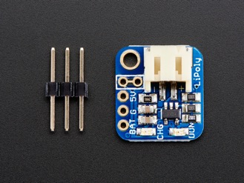
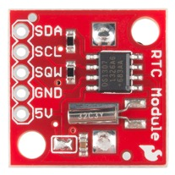
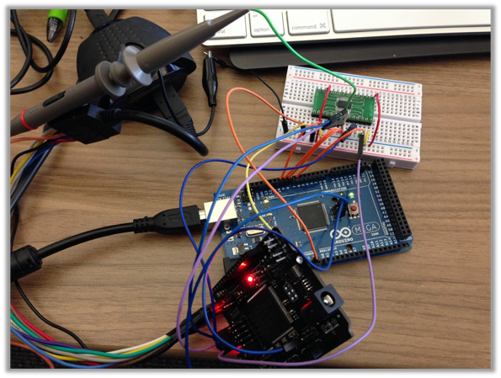
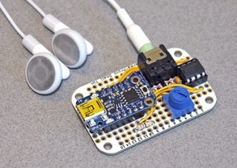
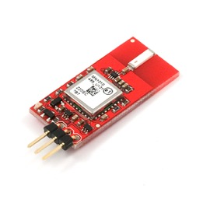
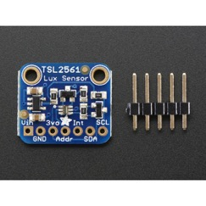
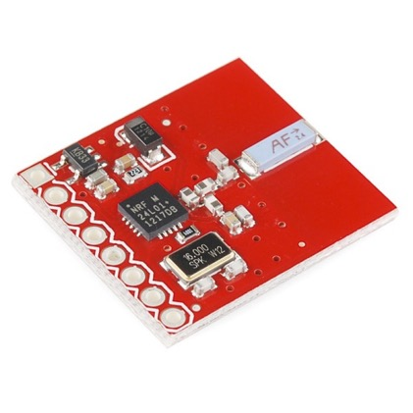
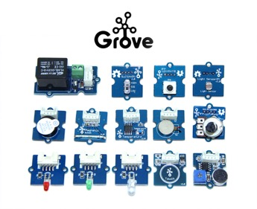
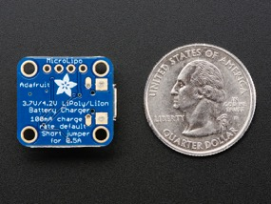
The circuit design workflow STEP ONE: CONCEPTUALIZATION
NRF24L01

Slide 37
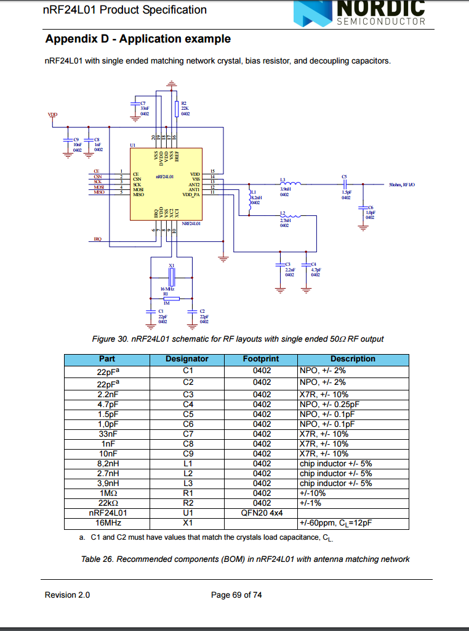
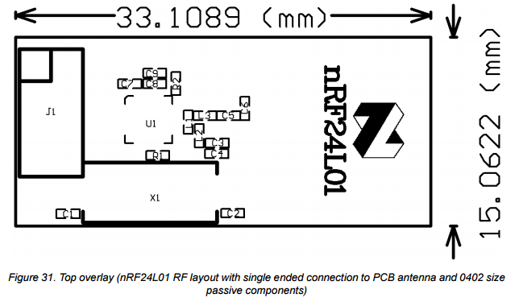
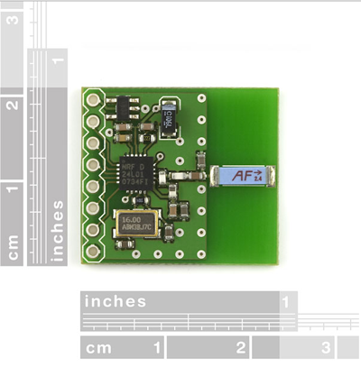
NRF24L01

Slide 38
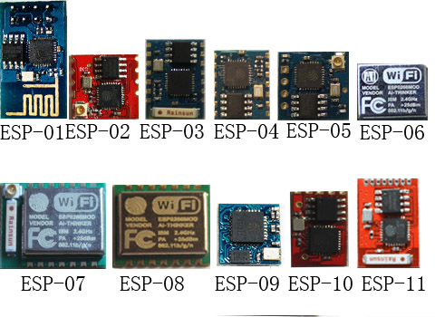
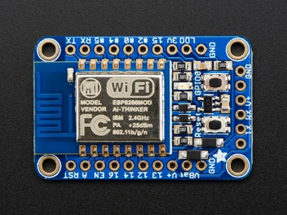
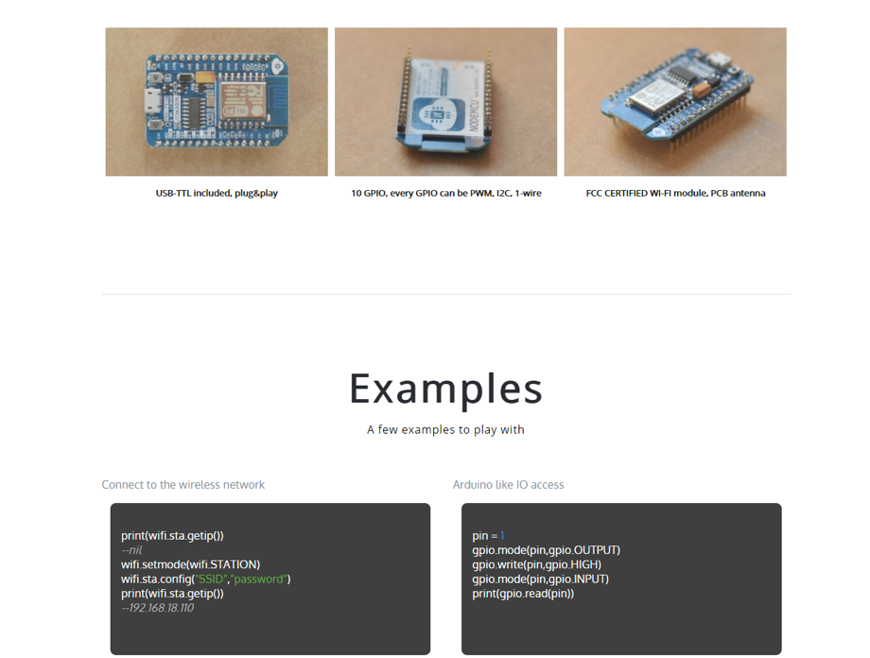
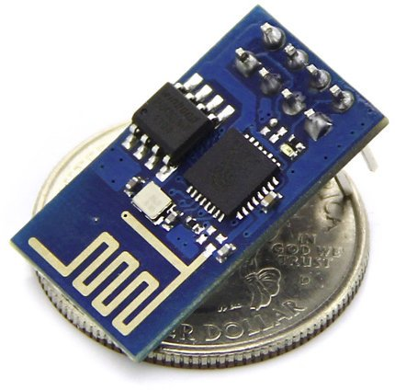

Slide 39
Storage
Control
Comms
Intelligence
Sensing
Power
Interface

Slide 40
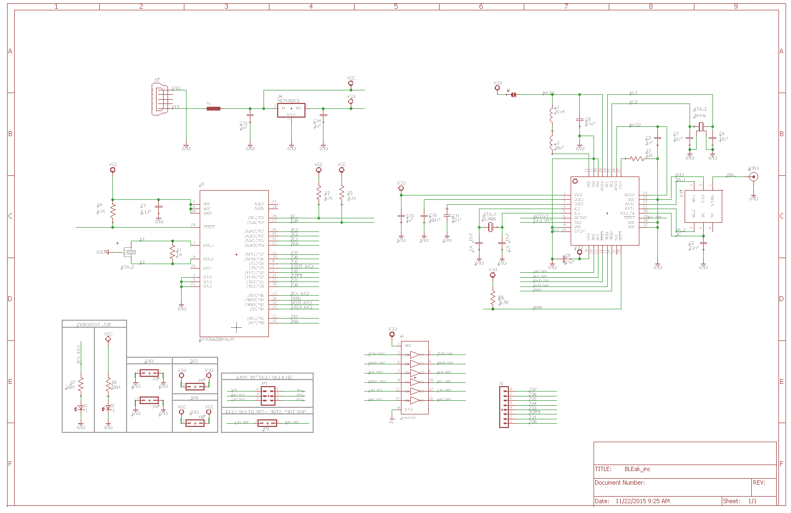
The circuit design workflow STEP TWO: SCHEMATIC CAPTURE

Slide 41
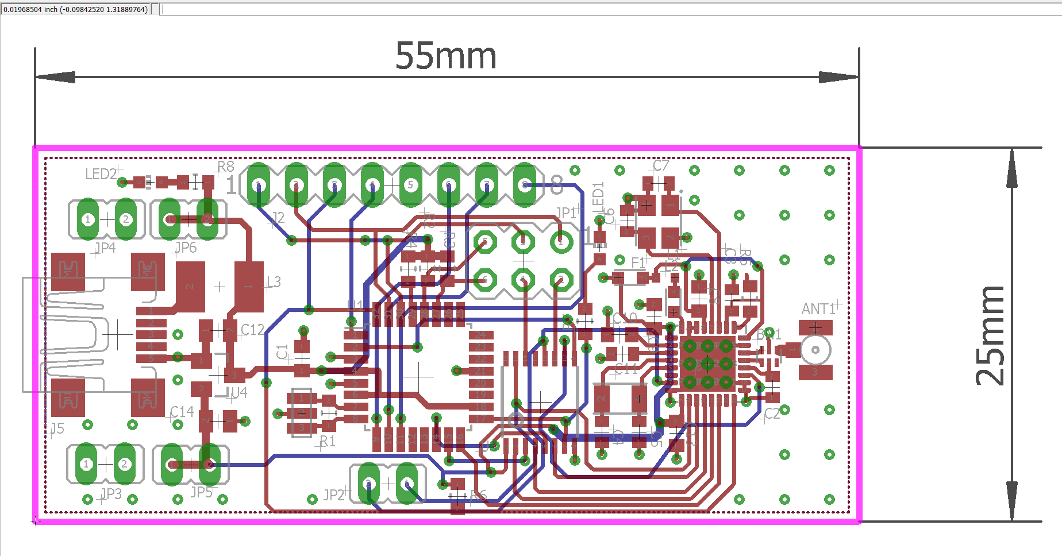
The circuit design workflow STEP THREE: PCB LAYOUT

Slide 42
Required Manufacturing Files STEP FOUR: COMPUTER-aided MFG (CAM)
Gerber
Flattened out, layer by layer artwork of the PCB presented
as flashes and draws (apertures) using D-Codes, Loc, etc
NC Drill
Drilling / milling information including tools, locations,
and route paths (plunge points, extraction points, etc)
Bill of Materials (BOM)
Component, fully-qualified part numbers, quantities,
manufacturers, distributor(s), equivalents (FFF), alternatives
Pick and Place File
Component part numbers, X:Y locations, orientations,
board layer (top or bottom)
IPC-D-356 Netlist
Testpoint report including testpoint location (usually pads
or vias), net name

Slide 43
Designing manufacturable PCBs

Slide 45
Level-Set: The world is not ideal
Copper is NOT a super conductor, nor is solder
Cu cannot carry infinite amounts of current
Pads have to be solderable! Must work on the assembly line
PCB traces have resistance, impedance, inductance
Pins and pads have capacitance, impedance
Vias are inductive, capacitive
Coupling occurs between tracks, polygons, planes, etc.
Noise propagates along signal paths, ground planes
Amplifiers amplify
Digital signals / components are noisy…
…Analog circuitry is susceptible to noise!
Antennas hear it all
Remember your R’L’G’C’s (*ok, this is pretty engineering heavy)
Gaaaaaahhhhh!
…YET we manage to build stuff that works every day, so chill

Slide 46
Developing some rules of thumb

Slide 47
CREATING COMPONENTS subheading: where experience rules

Slide 48
Device – symbol - Package
A | 1
K | 2
A
K
1
2
SYMBOL
PACKAGE

Slide 49
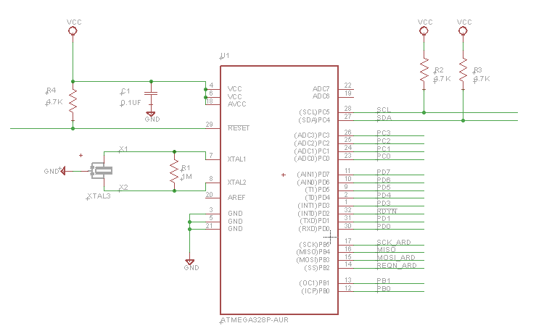
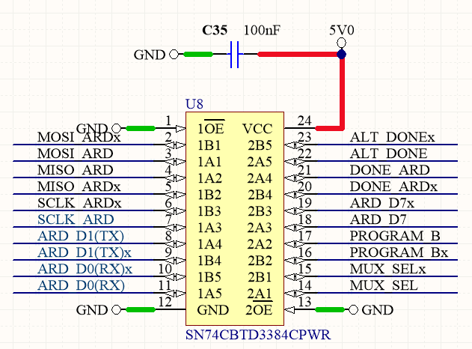
Building Awesome symbols
Group pins meaningfully
Consider wiring of the schematic
Consider flow of design
Traditional model
Power pins top, ground bottom*
Inputs left, outputs right
Pull ups pull up
Pull downs pull down
Clock pins need space
Make room for decoupling
Save space for series resistors

Slide 50
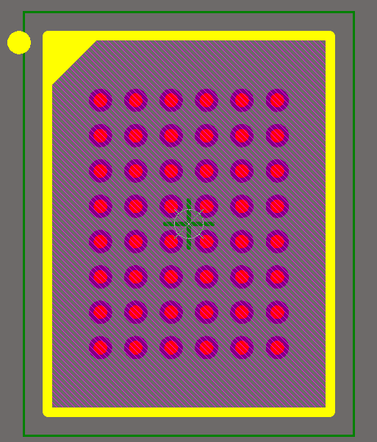
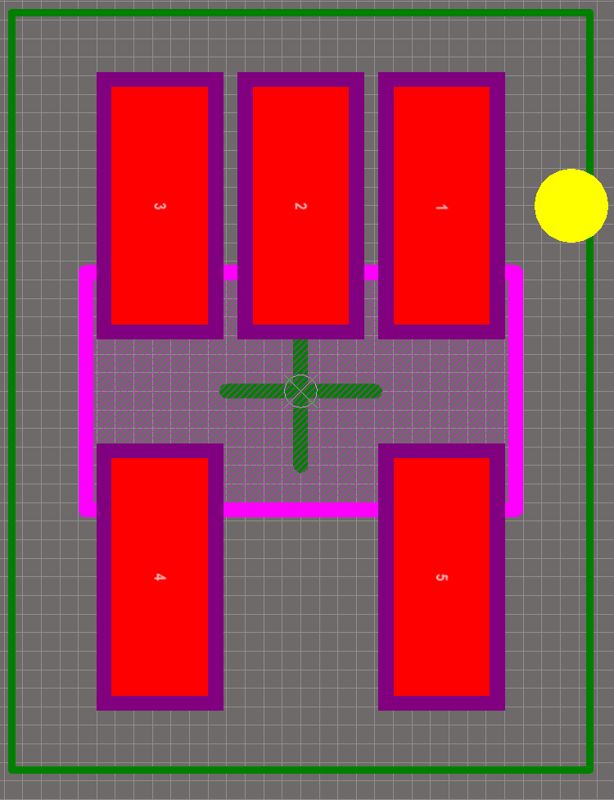
Building AWESOME FOOTPRINTS
It comes down to pad geometry and silkscreen!
IPC-7351 defines standards for land pattern & includes 3rd party calculator for component pad geometry
Some silkscreen tips:
Silkscreen line width 10 mils (play it safe)
Ensure silkscreen is visible from beneath the component (no point adding silkscreen under a part, can be problematic)
Ensure silkscreen boundary is wide enough to accommodate comp drift
Orientation details are critical
Direction, polarity (LEDs, polarized caps)
Pin-one markers (every IC should have a dot)

Slide 51
Pad Basics
Fall into one of two categories: thru-hole or surface mount
Pads are consistently larger than the component pin
Gullwing pads have a toe, a heel and a side, where other square pads have may have equally sized sides
Pads can extend outside of the body of the component, or leads may not be visible when components are mounted

Slide 52
Pad shape
SOIC and leaded gullwing pads (e.g. QFP) should be oblong, rounded-rectangles
Mark “Pin 1” with a square pad and a silkscreen dot beside it for clarity
Thru-hole pads are general circular though pins are commonly square or rectangular, ensure room to fit pins (include plating thickness in calculations)
SOT packages (e.g. LDOs, transistors) use square pads, rectangular
Leadless packages incl. QFNs, diodes, etc. commonly use square pads and vias for thermal relief
Discrete SMTs (resistors, caps) use square pads
Ball Grid Array (BGA) packages use round pads

Slide 53
Pad Size
Pad Dimensions
Package Dimensions

Slide 54
SOIC PAD EXAMPLE
Using Rounded Surface Mount Lands
Clean release from solder paste stencil
Reduces solder volume
A more natural shape for solder in its liquid form
Concentrates solder where it is most needed
Rule of thumb -> take nominal pad size and add 40 mils to length (20 toe, 20 heel)
Rule of thumb -> take nominal pad size and:
Pitch = 50mils, add 10 mils to the width
Pitch = 0.8mm, use 20 mils wide pads
Pitch = 0.65mm, use 16 mils wide pads
Pitch = 0.5mm, use 14 mils wide pads

Slide 55
Parts placement

Slide 56
Parts Placement
The world loves little cities…hates urban sprawl (don’t be LA, be Shanghai)
Group analog and digital circuits into separate sections
Keep sections (power, MCU, transceiver, analog, etc) tight though maintain enough room for soldering, esp. if soldering by hand
Watch the tall parts vs. short parts and don’t paint yourself into a corner when hand-soldering (can’t reach something)
Components slip when soldering (float), keep parts >10 mils apart for machine assembly and >20 for hand assembly unless you have serious soldering chops
Keep decoupling to w/in a min of 100 mil of the component pins, 50 mil is better
Keep analog circuits close to the board’s IO
Keep components 150mils from the edge of the board so clamps can be used

Slide 57
Track Width & routing

Slide 58
How do I pick a track width?
Power Supply -> Far more scientific…based on ampacity (current)
Current carrying capacity
Temperature Rise
Thickness of copper
Width of the track
Current requirements
IPC 2221 Formula:
i=K×∆T^{0.44}×Ac^{0.725}
Where:
i = required current
K = 0.048 for external layers
0.024 for internal layers
∆T = temp rise in ºC
Ac = cross sectional area (width x thickness)

Slide 59
How do I ROUTE IT?
12 mil
15 mil
Power Supply -> Some rules of thumb
Base your routing width on 1.5-2x the required current
Use planes whenever possible
Avoid long return paths, shorter is better, best = via to solid plane
Avoid long unterminated stubs (antennae)*
Give yourself meaningful clearance between traces
“Neck Down” tracks to enter pads at pad width or slightly smaller
Avoid splitting power and ground on the same layer
Avoid digital signals over analog ground planes (more on this)
* Straight conductors (unterminated) have parasitic inductance and concentrate flux lines (magnetics) from the world around them…this is the principle of a whip antenna and straight, unterminated tracks can operate like antennas on the board concentrating noise and introducing it to a circuit
20 mil
25 mil
30 mil

Slide 60
Digital Signals
Regarded as the noisy bunch, though reasonably noise-immune themselves
Should be kept as short as possible to avoid parading noise around the board
Should be kept away from sensitive analog signals where possible and avoid crossing analog GND planes
Run orthogonal on adjacent layers to limit crosstalk and noise issues
Isolate digital ground from analog ground wherever possible*
*does not apply to ADCs and DACs…a DACs DGND and AGND pins should both be tied to AGND plane as close to the component as possible →→→→→

Slide 61
How do I pick a track width?
15 mil
12 mil
Digital Signals-> <= Scientific (High speed excepted)
Some rules of thumb
As trace width decreases, resistance increases
As length increases, so does resistance
As trace width increases, capacitance (particularly with the presence of a GND plane) increases
Under most non-RF or non-”High Speed” circumstances, it is aesthetics and cost (PCB fab) that drive this
- W < 5mil = ↑$...
Typical track widths: 5, 7, 8, 10, 12, 15, 20, 25, 50…
You can use larger tracks to make life simpler
10 mil
7 mil
5 mil

Slide 62
How do I pick a track width?
15 mil
12 mil
Digital Signals-> Some rules of thumb
Wider traces are easier to etch chemically and route with a CNC machine
Building in-house prototypes, look for 15 mil tracks and 15 mil spacing min. unless using a precision mill
Chemical etch can be hard to time right, unpredictable, good to “go big”
PCB manufacturer’s can reliably handle 5mil tracks and 5mil spacing (so-called 5x5)
Larger tracks / spacing = better yield = lower cost
Don’t overdo it…no one likes and overachiever when it comes to track width (don’t waste space)
Super-wide tracks introduce additional capacitance, can be problematic in higher speed circuits
10 mil
7 mil
5 mil

Slide 63
Via / Hole size
Ex. Sunstone Circuits
Selecting a via size for “typical” circuits
Most low-cost fabs will require >= 15 mil via holes
Full service board houses will provide sizes much smaller but typically charge more for <= 12 mil diameter
Aim for 1.8x-2.0x hole diameter for annular ring size
Manufacturer’s will “round” to their nearest size and all mfg will have a standard size they recommend / prefer

Slide 64
Power Supply Clearances
Power Supply -> Some rules of thumb
IPC-9592 specifies that for voltages .>= 100V, the formula for minimum clearance vs. voltage to be (linear):
SPACING (mm) = 0.6 + Vpeak x .005
For voltages < 100V the formula is:
0.13mm for V<15V
0.25mm for 15V≤V<30V
0.1+Vpeak×0.01 for 30V≤V<100V
Larger clearances are better and a nice rule of thumb is to allow clearance to match track width for most low-voltage circuits (for power):
20mil track x 20mil spacing
RULE: Don’t follow this chart…this is a minimum…maintain a minimum of 10 mils clearance for low power nets and life will be good (most of the time:)

Slide 65
Power distribution & GROUNDING

Slide 66
Power Distribution Networks
Power lines should be kept to the lowest possible impedance √(L/C)
Greater width = lower impedance, thicker copper = lower impedance
Long power lines couple in more noise from other parts of the circuit and parade that noise everywhere they go…keep @%^& short and isolate!
Single GND, Shared Return Path
Multiple returns, shared return path
Multiple returns, isolated return paths

Slide 67
Power Distribution Networks
Ground planes should be unbroken where possible
Ground planes should not be mixed with power or other signals where possible
Route digital signals *around* analog ground planes
Isolate returns whenever possible (nobody likes the noisemakers at the party)
Single GND, Shared Return Path
Multiple returns, shared return path
Multiple returns, isolated return paths

Slide 68
TIPS
Follow the IPC Specifications (IPC-7351)
Designed to remove ambiguity with SMT parts handling and PCB land-pattern geometries
Comes with IPC Footprint Calculator
Refer to IPC-7351 tables 3.1 – 3.22
Join forums like www.pcblibraries.com or the IPC designer’s council forum
Manufacturers will be able to tell you minimum / recommended annular ring on thru-hole pads
Get samples, print the design 1:1 and have a look…May not tell you it’s mfg-worthy but will tell you if the overall size is completely wrong
Pay careful attention to pad numbering
Never obscure pads with silkscreen or anything else
Ask, ask, ask…Average the answers :)
…And (note to self) always tent the vias under your BGAs

Slide 69
Links or stuff to get, read, learn
IPC2221 (Free online…you’ll find a PDF, just have a copy)
IPC2152 – like 2221 but more accurate and more use of tables
IPC7351 – buy this little jewel…it may be pricey but it’s worth it
Join forums:
Electronics Exchange
All About Circuits
PCBLibraries.com
IPC Designer’s Council
Search – PCB Pad Size, PCB Footprint Size, PCB Land Pattern
Saturn PCB calculator – you want this
AppCAD PCB – you want this
PCB Library Expert Lite – Free, you want this…always nice to buy it if you can
Read the books from the American Radio and Relay League
US Navy electronics resource are decent

Slide 70
Links or stuff to get, read, learn
Good soldering kit – Aoyue, Weller (though specialized tips on some)
Multimeter
USB to serial port adapter (you will need this with great frequency)
Oscilloscope – you need to get eyes into your circuit
Logic analyzer (USB are ok…look at Saeleg, not bad, min 8-channel)
Tweezers (Vetus brand are nice, you want decent sets of different tips, hooks are the best)
Solder + flux (flux should be both a jar of paste and a pen)
PCB circuit cleaner (spray from RadioShack)
A few extra tooth brushes for cleaning boards, soft tip, none of that wonky gum massage nonsense
XACTO knife with replacement blades
Wire strippers
Solid core wire (22 gauge)
Stranded wire (important to take stress off of solder joints)
Hot air setup / hotplate

